Slide 1

MapReduce
Design Patterns
Donald Miner
Greenplum Hadoop Solutions Architect
@octopusorange

Slide 2
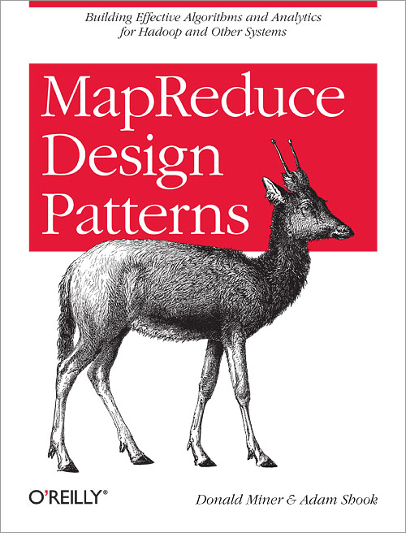
New book available December 2012
Notes:
Quick overview of book
This talk is not to sell you on the book, its to sell you on why MRDPs are important for the community

Slide 3

Inspiration for my book
Notes:
Story about explaining joins
Teaching hadoop classes and explaining how to solve problems was challenging
Most of the stuff in this book is not novel– it’s been collected through different sources

Slide 4
What are design patterns?
Reusable solutions to problems
Domain independent
Not a cookbook, but not a guide

Slide 5
Why design patterns?
Makes the intent of code easier to understand
Provides a common language for solutions
Be able to reuse code (copy/paste)
Known performance profiles and limitations of solutions

Slide 6
MapReduce design patterns
Community is reaching the right level of maturity
Groups are building patterns independently
Lots of new users every day
MapReduce is a new way of thinking
Foundation for higher-level tools (Pig, Hive, …)

Slide 7
Sample Pattern: “Top Ten”
Intent
  Retrieve a relatively small number of top K records, according to a ranking scheme in your data set, no matter how large the data.
Motivation
  Finding outliers
  Top ten lists are fun
  Building dashboards
  Sorting/Limit isn’t going to work here

Slide 8
Sample Pattern: “Top Ten”
Applicability
  Rank-able records
  Limited number of output records
Consequences
  The top K records are returned.

Slide 9
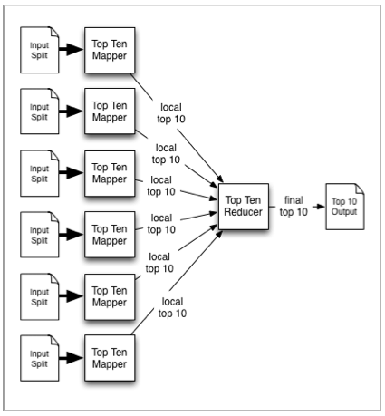
Sample Pattern: “Top Ten”
Structure
class mapper:
setup():
initialize top ten sorted list
map(key, record):
insert record into top ten sorted list
if length of array is greater-than 10:
truncate list to a length of 10
cleanup():
for record in top sorted ten list:
emit null,record
class reducer:
setup():
initialize top ten sorted list
reduce(key, records):
sort records
truncate records to top 10
for record in records:
emit record

Slide 10
Sample Pattern: “Top Ten”
Resemblances
  SQL:
  SELECT * FROM table ORDER BY col4 DESC LIMIT 10;
  Pig:
  B = ORDER A BY col4 DESC;
  C = LIMIT B 10;

Slide 11
Sample Pattern: “Top Ten”
Performance analysis
  Pretty quick: map-heavy, low network usage
  Pay attention to how many records the reducer is getting
  [number of input splits] x K
  (memory, nonparallel)
Example
  Top ten StackOverflow users by reputation

Slide 12
Pattern Template
Intent
Motivation
Applicability
Structure
Consequences
Resemblances
Performance analysis
Examples
Notes:
Spend time talking about each and what purpose they have
Remember the mention that examples are in Hadoop

Slide 13
Pattern Categories
Summarization
Filtering
Data Organization
Joins
Metapatterns
Input and output
Notes:
Just briefly outline

Slide 14
Summarization patterns
Numerical summarizations
Inverted index
Counting with counters

Slide 15
Filtering patterns
Filtering
Bloom filtering
Top ten
Distinct

Slide 16
Data organization patterns
Structured to hierarchical
Partitioning
Binning
Total order sorting
Shuffling

Slide 17
Join patterns
Reduce-side join
Replicated join
Composite join
Cartesian product

Slide 18
Metapatterns
Job chaining
Chain folding
Job merging

Slide 19
Input and output patterns
Generating data
External source output
External source input
Partition pruning

Slide 20
Future and call to action
Contributing your own patterns
  Should we start a wiki?
Trends in the nature of data
  Images, audio, video, biomedical, …
Libraries, abstractions, and tools
Ecosystem patterns: YARN, HBase, ZooKeeper, …

Slide 21


